Slide 1
Regional Playstyle & Strategic Differences Among
Major Professional League of Legends Leagues
Team 07: Brian Park, Akbar Wibowo, Andy Chen, Drishti Chulani, Lorelei Liu, Suji Kim

Slide 2
Table of contents
01
02
03
04
05
06
Overview
Data
Analysis Part I
Sources
Cleaning
Player Focused Analysis
Overview
Problem Statement
Motivation
Analysis Part II
Analysis III
Conclusion
Team/Region Focused Analysis
The Ultimate Winning Formula
Challenges
Recommendation
Next Steps

Slide 3

01
overview

Slide 4

project overview
Esports has grown into a global entertainment ecosystem, with League of Legends (LoL) as one of the most watched and strategically complex titles.
In LoL’s main mode, Summoner’s Rift,
teams of five compete through map control,
resource management, and coordinated team play.
This project analyzes player and team performance data (2020–2024) to uncover trends that drive competitive success.

Slide 5

Problem statement
Professional LoL regions: LCK (Korea), LPL (China), LEC (Europe), LCS (North America); are known for distinctive strategic identities.
This project investigates:
How regional playstyles differ today
How these styles evolved from 2020–2024
Which strategic tendencies most strongly correlate with higher win rates
Which player behaviors define each region’s competitive identity
Notes:
For the scope of our project we looked into LoL Esports’ four major regions, and analyzed their strategic tendencies

Slide 6

Motivation
Regional differences have historically defined competitive League of Legends — from Korea's disciplined macro play to China's fast-paced aggression.
As international competition intensifies and metas globalize, do these regional identities still persist or have they converged?
Understanding this evolution informs talent scouting and team strategy, while revealing how historical trends shape competition in a global digital sport.
Notes:
We looked into this data to see whether regional identities still persist or not as League enters its 15th/16th year of competition.

Slide 7

02
Data

Slide 8
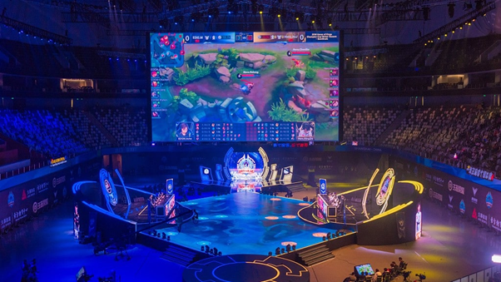

Data Sources
LoL Esports Player Data
Player-level metadata;
in-game names, legal names, birthdates, nationalities, team history
Data Size: ~800 rows
LoL Esports Match Data
Detailed match statistics across global leagues from 2020–2024
Data Size: ~145,080 rows

Slide 9

Data Cleaning
Team / non-team split
The main dataset had both team level rows and individual player rows and each represented different variables, hence we separated them for data integrity
Uneven rows
There were uneven data across columns as Players and Teams had different sets of distinct variables.
So we removed the irrelevant column from each dataset.
Home region mapping
The teams and the players lacked regional labels that are essential for our analysis, so we created a new column and mapped it using their domestic league

Slide 10

03
Part i
Player Focused Analysis

Slide 11
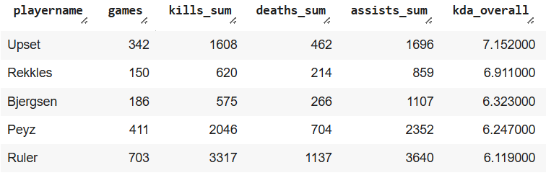
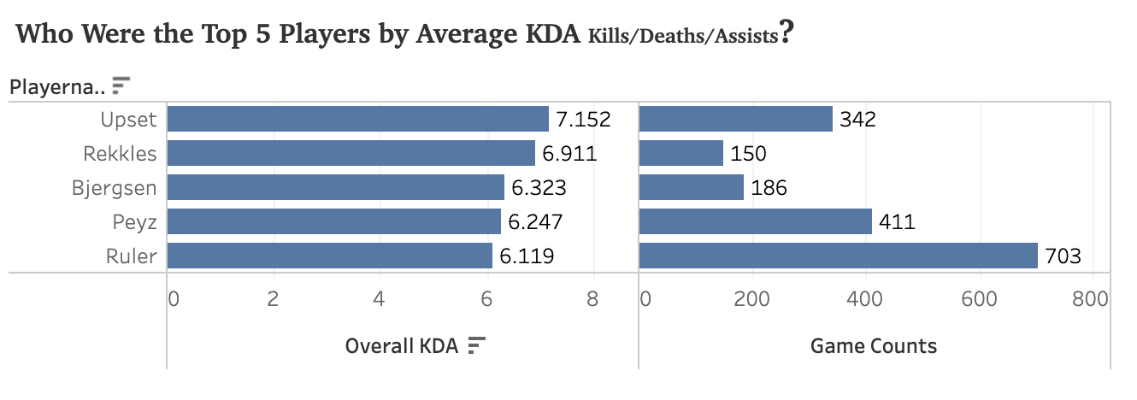
Q. top 5 players by average
Kill/death/assist

Slide 12
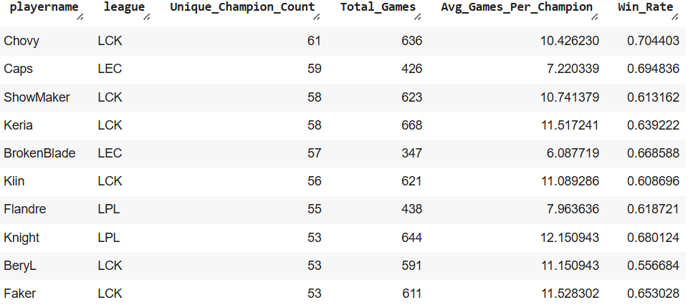
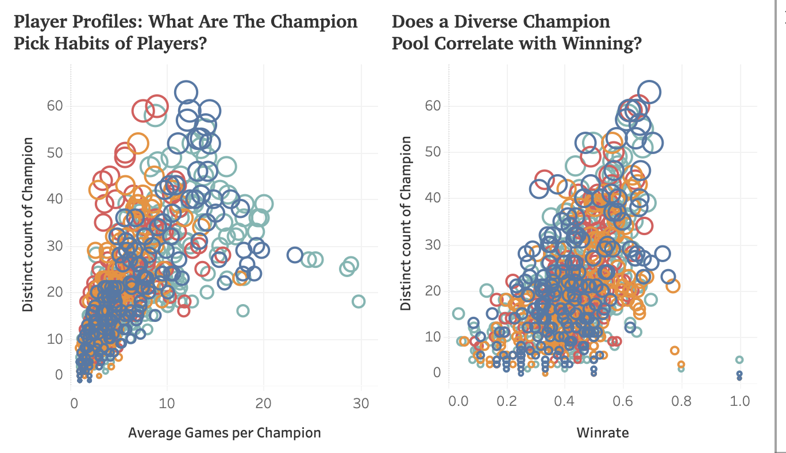
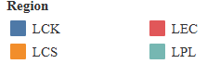
Q. do champion pick habits have an impact on win rate?
Specialists
Generalists
Elite Level
Notes:
Next, we took a look at the champion pick habits of all the players in our data. In the first scatterplot on the left, three subgroups can be distinguished. The first is the specialists, which have high numbers of games per champion, but a limited cast that they choose from, seen by the handful of stragglers jutting out towards the right. Next is the generalists, who play a wider breadth of champions, but have fewer average games per champion. At the peak of the graph, you’ll see a select set of elite level players, who have both a wide cast of champions and many average games on them. The same set of players also dominate the peak in the right graph, who average above a 60% winrate, showing mastery over a very wide pool of characters.

Slide 13


04
Part ii
Team/Region Focused Analysis

Slide 14
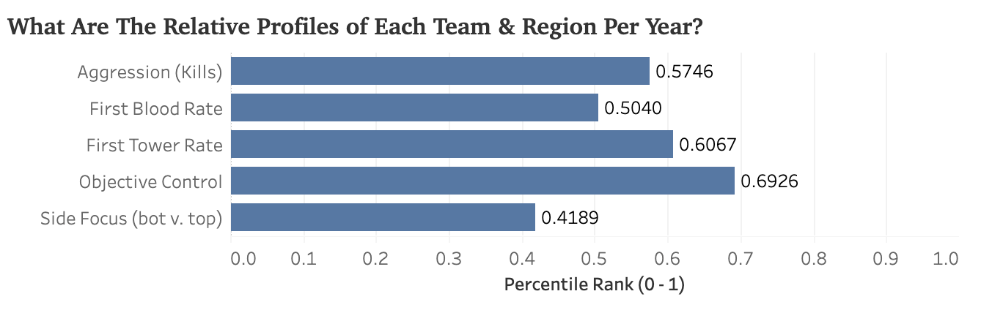
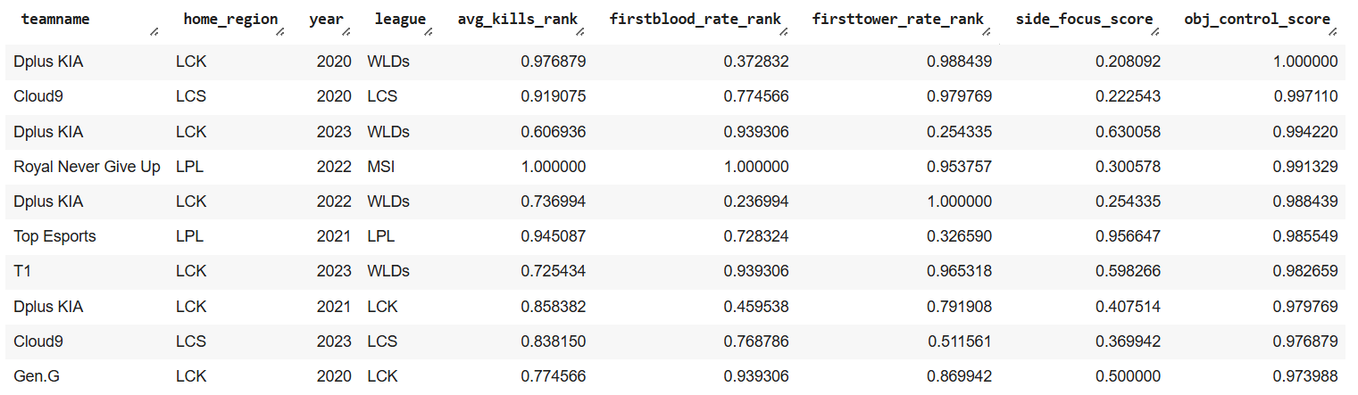
Q. What are the relative profiles of teams and regions?
Each matrix is converted to a percentile score from zero to one, allowing us to make apples-to-apples comparisons across years and the strongest distinguishing variable is objective control.
Notes:
By ordering this query by obj_control_score, we attempted to reveal similarities among the most dominant teams in the game's history, and their playstyle profiles. In this table, we found that aggression (firstblood) to vary greatly, but found a correlation between teams that focus most of their efforts top side (obtaining heralds over dragons) to have a higher first tower acquisition rank relative to their competition. Faster snowballing from early acquired leads appear to be the most common trait among truly dominant teams.

Slide 15
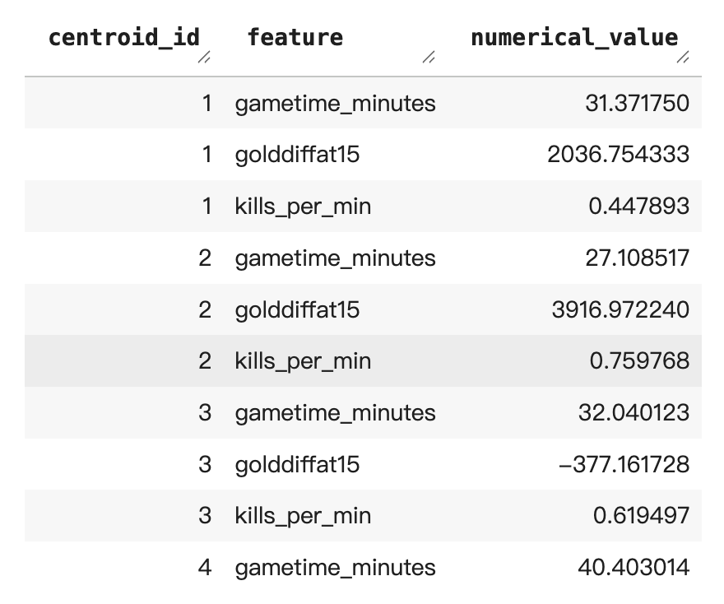
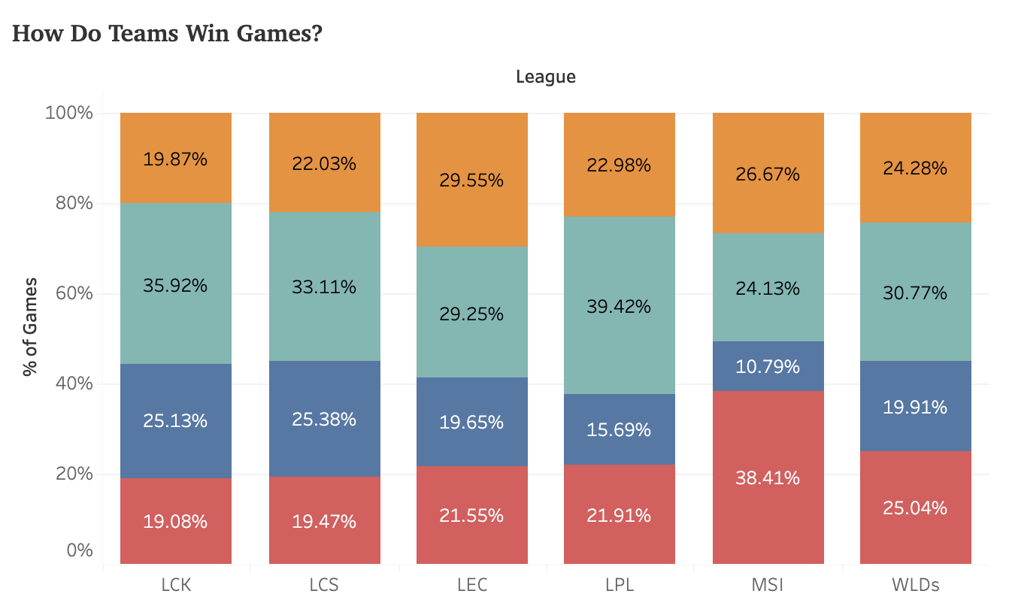
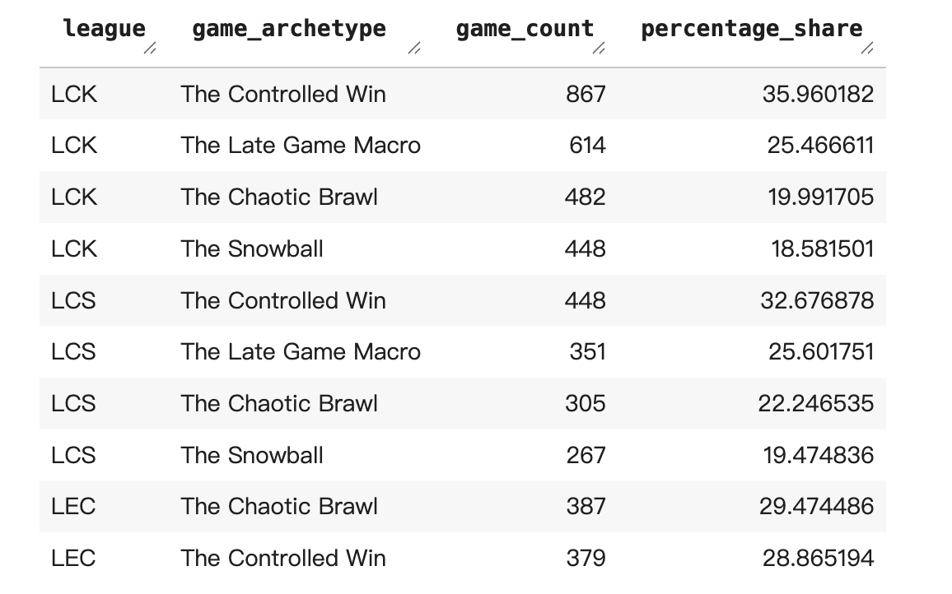
q. How do Teams win games?

Slide 16
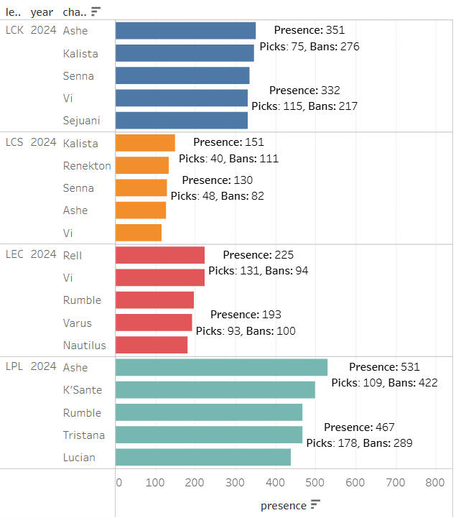
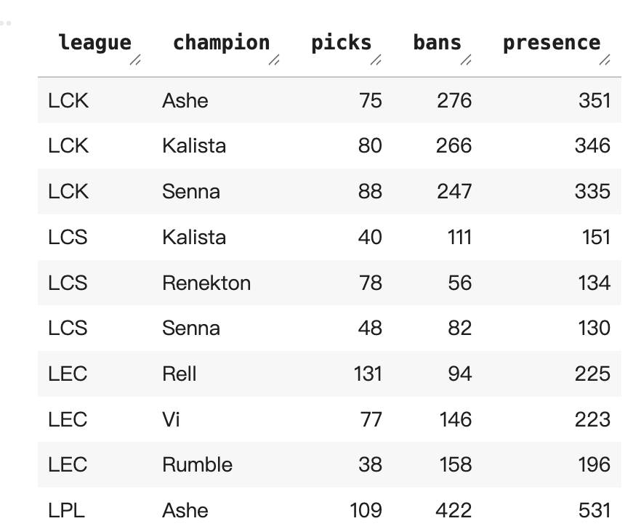
Q. What Are The Most Picked/Banned Champions in Each League?
Notes:
This is the biggest point of difference in regions.
Differences in game counts are due to format differences in regions (LCK and LPL play best of 3’s, whereas LEC and LCS only play best of 1’s)
Early skirmish champ presence in LEC aligns with their preferred win style.

Slide 17

05
Part iii
The Ultimate Winning Formula:
How Teams/Regions Win Games?

Slide 18
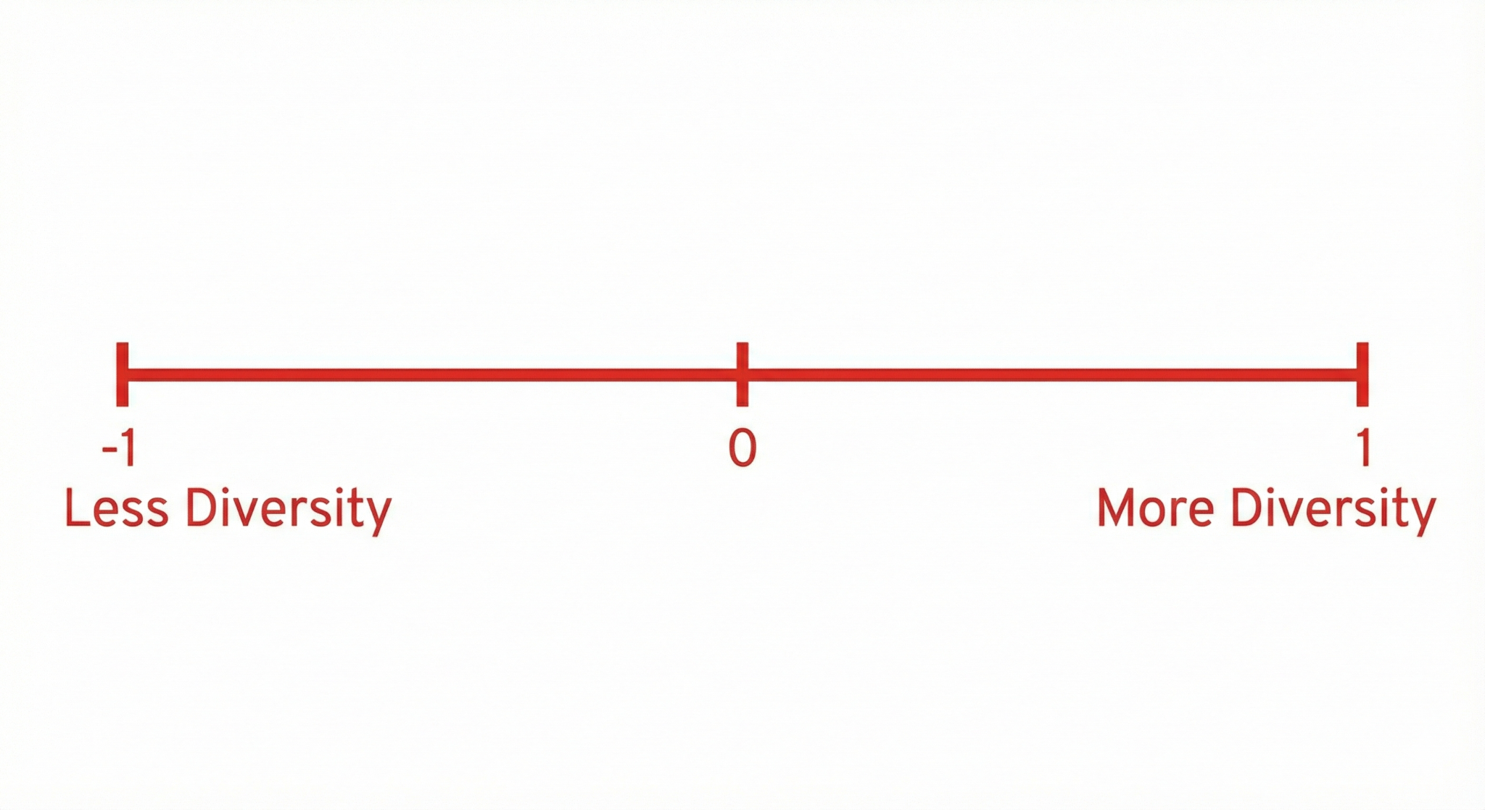

Q. champion diversity impact on success in regular season vs. playoffs
Stage | corr_entropy | corr_unique
Regular | -0.064143 | -0.036065
Playoffs | 0.579985 | 0.580548
Regular Season: Favors steady, known meta picks to reduce variance and risk.
Playoffs: A wider breadth of picks, with unpredictable pocket picks.
Notes:
First, we attempted to analyze champion diversity’s impact on success in the regular season and playoffs. A -1 will correlate no diversity with winning, while a +1 will correlate complete diversity with winning. Our corr_unique metric correlates the pure diversity in picks, while corr_entropy correlates its distribution– meaning, the same two players might play the same 10 champions, but one might pick them evenly while the other picks one or two for 90% of their games while reserving a select few for the other 10%. In the regular season, we see that a predictable, rote cast of champions is great for consistently grinding out wins. In contrast, the higher stakes in playoffs favor bolder, less predictable picks with winning.

Slide 19
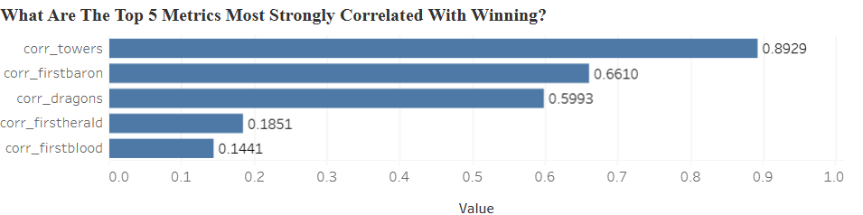
Q. What Are The Top 5 Metrics Most Strongly Correlated With Winning?

Slide 20
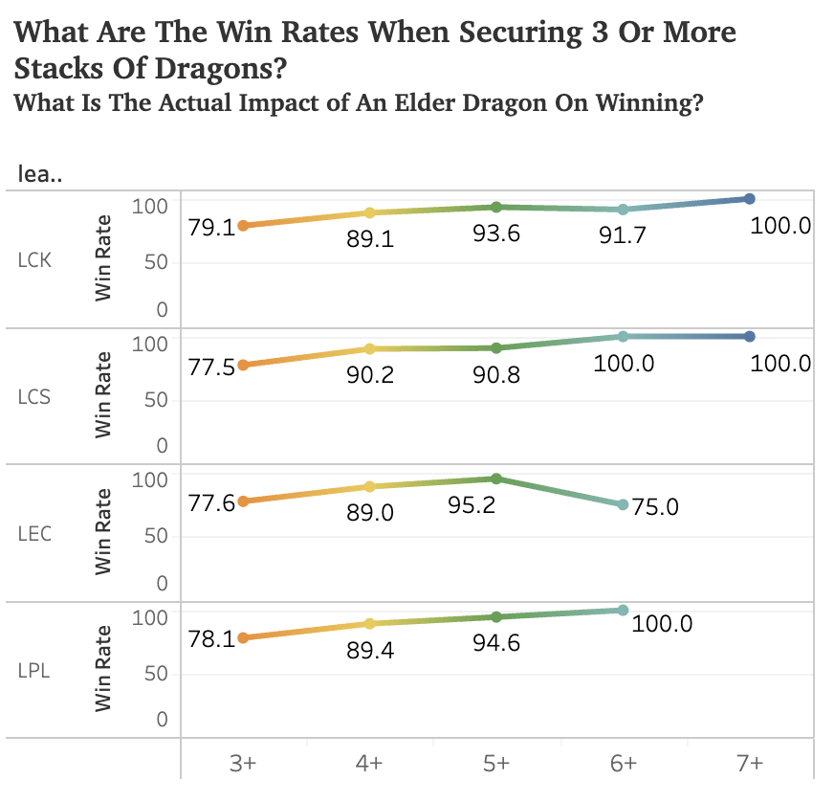

Q. what is the impact of securing 3+ dragons?
Notes:
This slide is pretty weak, could replace with the 3+ dragons query

Slide 21

06
Conclusion

Slide 22
Key insights
recommendation
Regional playstyles stay mostly consistent over time, with champion pick/ban priority being the biggest differentiator.
Successful teams share strong objective and vision control, with many top teams leaning on top-side pressure to accelerate early leads.
Winning isn’t driven by one metric— it's the interaction of champion priority, flexibility, and regional strategy that creates a competitive edge.
Value adaptability over age: Prioritize players with flexible champion pools and creative drafts.
Strengthen solo lanes: Invest in top/mid laners who can drive early objective control.
Use smarter metrics: Include comeback ability and under-pressure performance in player evaluation.
Reward meta agility: Favor players who consistently adapt to patch and meta changes.

Slide 23
challenges
Next steps
In-game tempo modeling: Quantify tempo swings and gold acceleration patterns that differentiate elite teams with temporal data.
Cross-regional scrim performance analysis (if data available): Compare scrim-based vs. stage-based tendencies.
Win-path prediction: Quantify how early leads translate into win probabilities.
Complex queries: Comparing time-based metrics (GD@10 vs. GD@25) required layered subqueries and case logic, making cross-match aggregation computationally heavy.
High dimensionality: With 113 columns, selecting meaningful features needed careful filtering and strong game-specific knowledge.
Patch and meta shifts: Maintaining consistency was difficult due to balance updates, meta changes, and champion reworks affecting season-to-season comparability.

Slide 24
Tableau
https://public.tableau.com/app/profile/suji.kim4394/viz/Team7_BA775_FinalProject_17652101237440/Dashboard1

Slide 25

References
Leaguepedia Data Portal
Riot Games API Reference
https://www.sciencedirect.com/science/article/pii/S2451958825001332#bib8
https://www.kaggle.com/code/omarmedhat1/league-of-legends-champions-data-analysis

Slide 26





Thank you!
Any questions?

